Slide 1
Predictive Modeling And Analysis of Software Engineers Salary Using Machine Learning
Presented By :
Al- Sadman Ahmed - 2022124642
Md. Masud Shohail - 2022123642
Payel Zaman Tithi - 2021476642

Slide 2
The idea of the project
This project focuses on building a machine learning model to predict software engineer salaries based on key factors like market standards, individual experiences, qualifications, geographical locations. The goal is to help both recruiters and job seekers make more informed decisions by offering accurate, data-driven salary estimates. With this model, recruiters can offer competitive salaries aligned with market conditions, and job seekers can set realistic expectations. By reducing the guesswork and potential salary mismatches, the project aims to create a more efficient and transparent hiring process in the tech industry.

Slide 3
Dataset
Source: Stack Overflow (https://insights.stackoverflow.com/survey)
Content: Predictive Modeling And Analysis Of Multiple Country’s Software Engineers Salary Using Machine Learning
Feature number: 50+
Rows: 89,185
Types: Categorical and Numerical

Slide 4
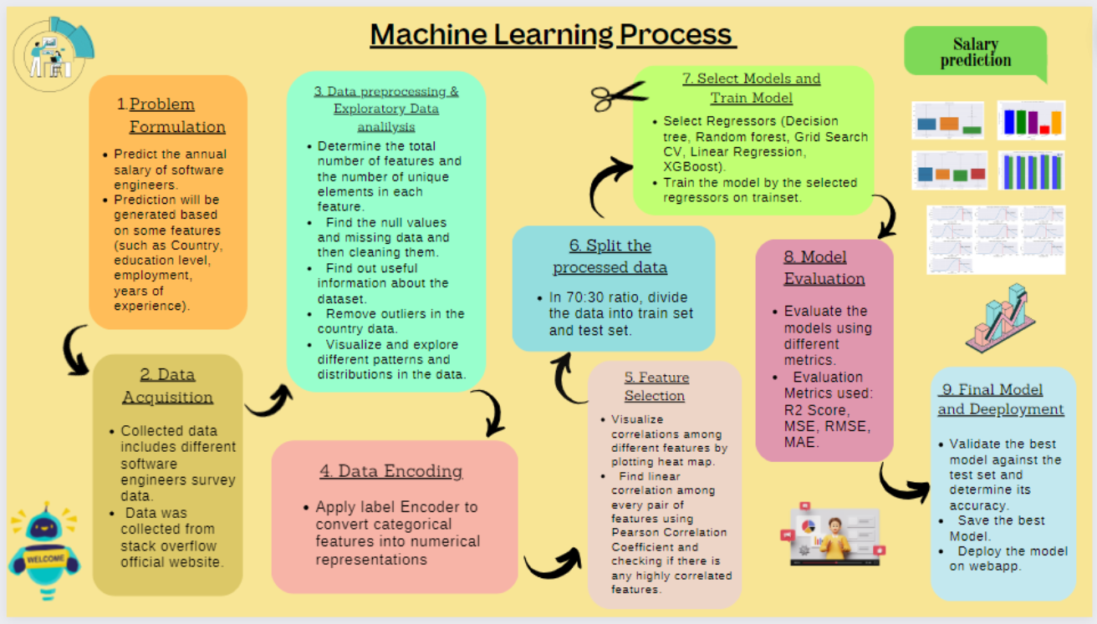
Flow Chart Of Research Methodology

Slide 5
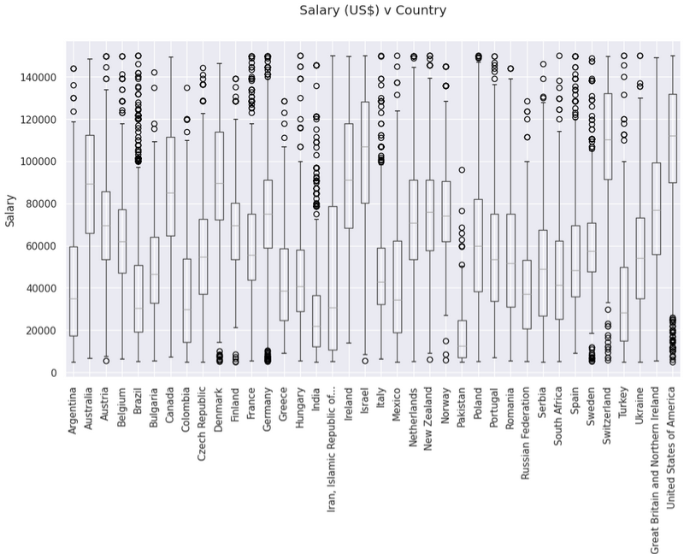
Salary Vs Country

Slide 6
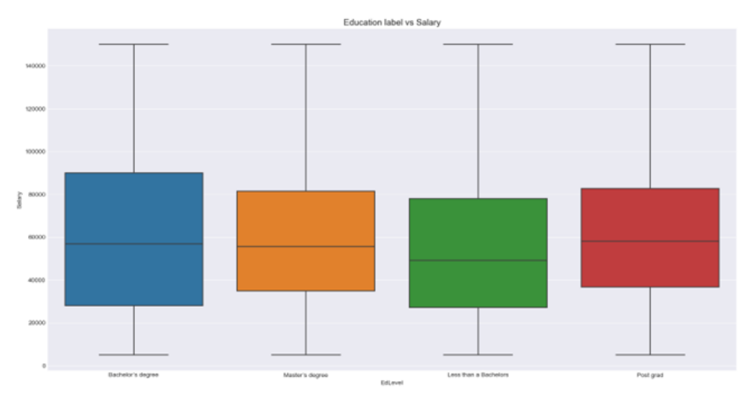
Educational Level Vs Salary

Slide 7
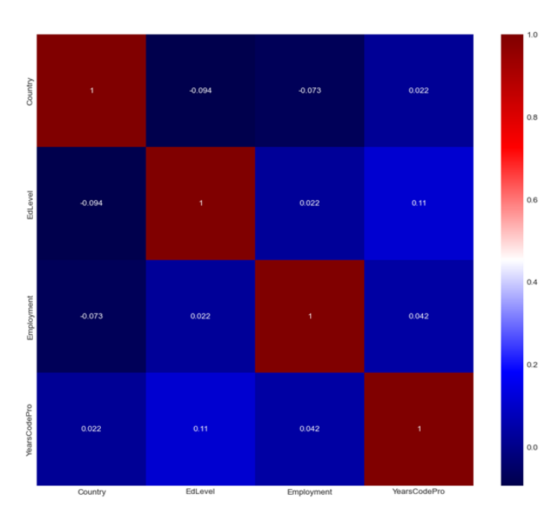
Co-Relation Between Different Features

Slide 8
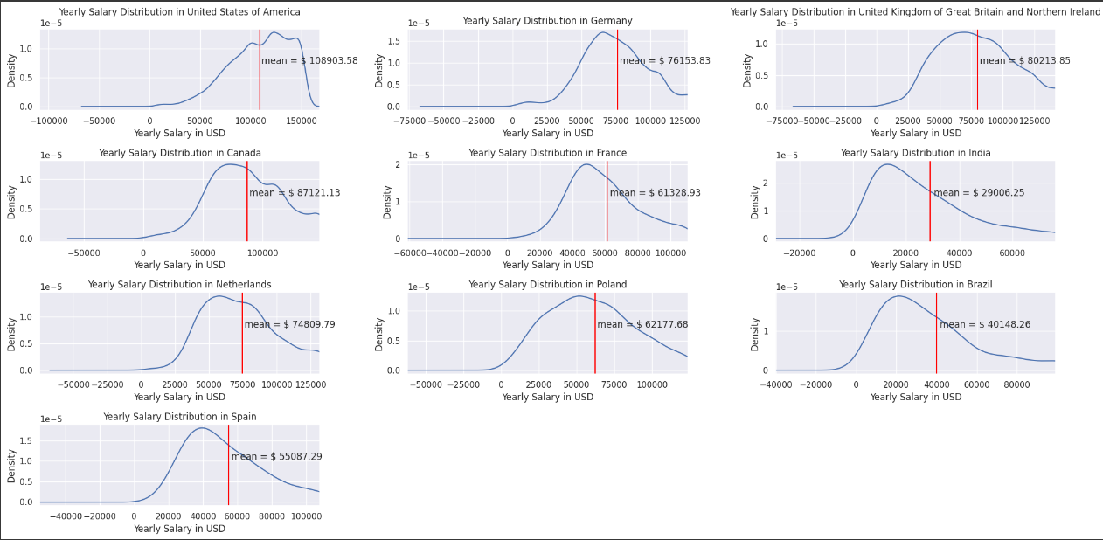
yearly salary distribution in various countries

Slide 9
Model Selection
In our project, we have used total 5 regressors. They are
Decision Tree Regression
Random Forest Regression
Ada Boost
Gradient boost
Xg boost

Slide 10
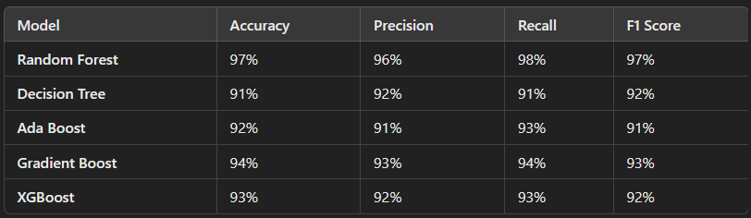
Result

Slide 11
Future of the Project
Add More Features
Enhance the Model
Feature Engineering
Use External Data
Explainability
Real-World Application
Continuous Updates

Slide 12


